Slide 1
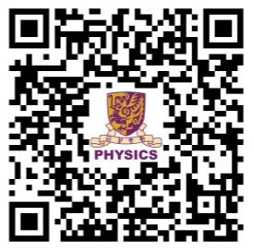

Admission talk for 2027 Physics @ CUHK
(JUPAS 4601 CUHK Broad-based Science 大類收生)
(JUPAS 4690 Enrichment Stream in Theoretical Physics 理論物理精研)
Department of Physics JUPAS hotline
Email: ugadm@phy.cuhk.edu.hk Tel: (852) 3943-6154

Slide 2
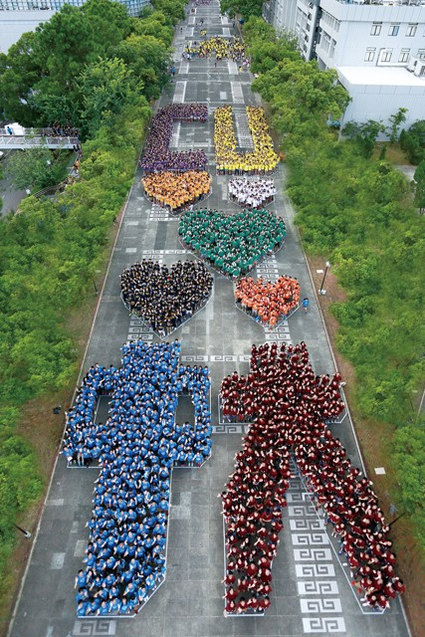
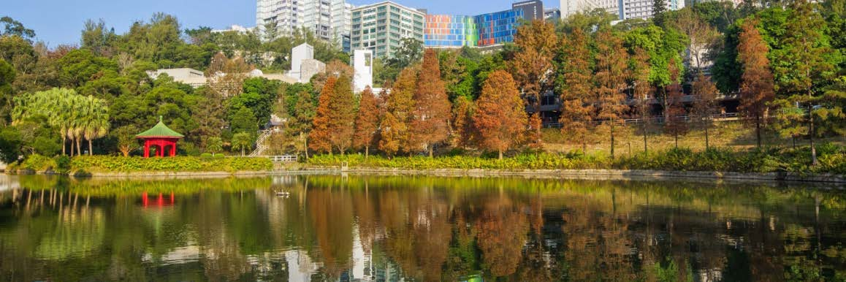
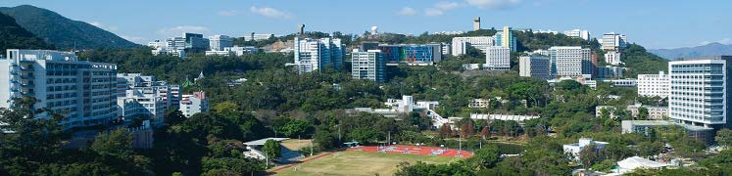
香港中文大學
The Chinese University of Hong Kong
未圓湖及獅子亭
百萬大道

Slide 3

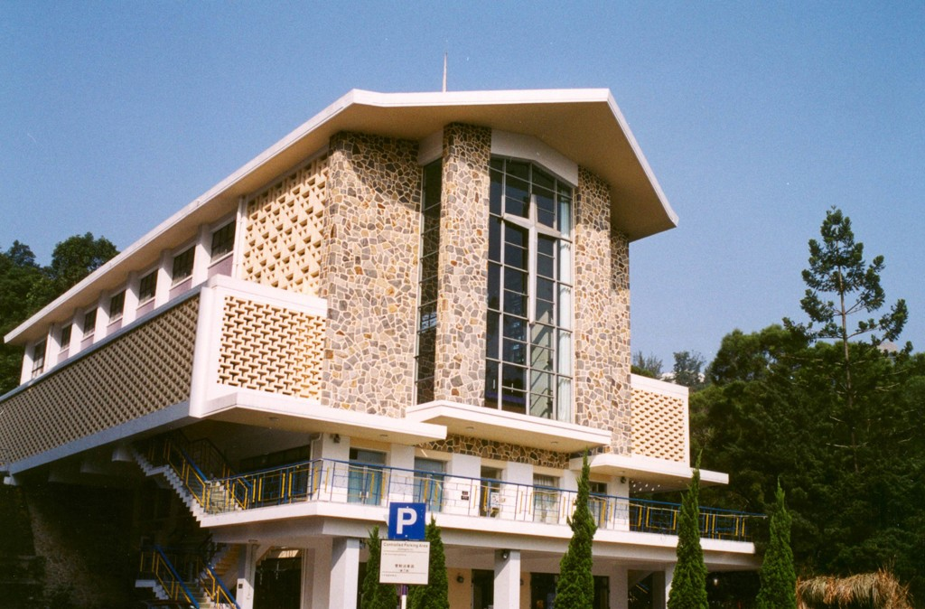
A comprehensive university founded 1963 as a federation of Chung Chi (崇基), New Asia (新亞) and United (聯合) Colleges 書院.
Currently, 9 colleges 書院 (崇基、新亞、聯合、逸夫、晨興、善衡、敬文、伍宜及 和聲) and 9 faculties/schools 學院 (Arts 文學, Business 工商管理, Education 教育,
Engineering 工程, Law 法律, Medicine 醫, Science 理, Social Science 社會科學and Graduate School 研究院).
崇基禮拜堂
新亞合一亭

Slide 4
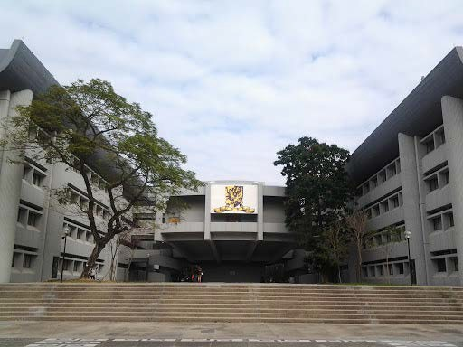
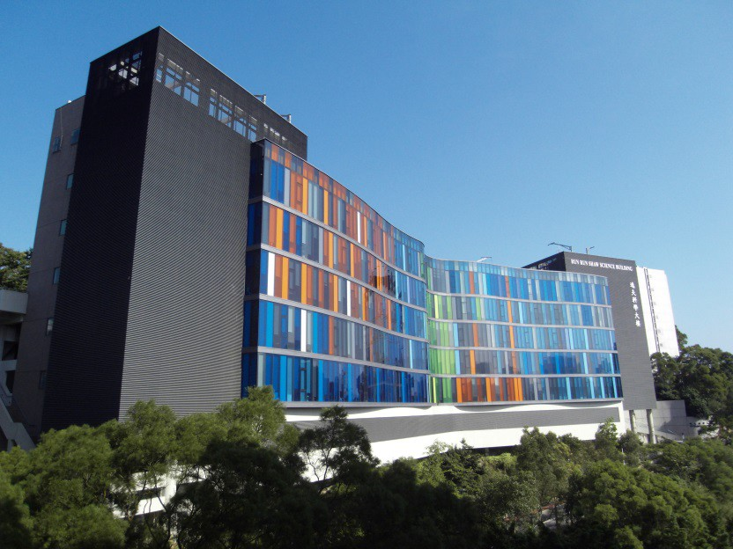
Department of Physics 物理系
Founded more than 60 years. One of the oldest in CUHK.
17 Professors 教授, 2 Associate Professors 副教授, 8 Assistant Professors 助理教授, 5 Research Assistant Professor 硏究助理教授, and 7 Principal Lecturer / Senior Lecturers/ Lecturers 講師 → 39 faculty members
科學館
逸夫科學大樓

Slide 5
You may want to study physics if you want to:
know how Nature works: From the atom to the universe
become a scientist 科學家, a physics professor 物理教授, a AI specialist 人工智慧專家, a science teacher 理科老師, an engineer 工程師, a financial analyst 金融分析師, ……
or even start your own innovative technology company 科技初創公司

Slide 6
CUHK Physics is the place for you because we care very much about
teaching 非常關心教學
CUHK Physics has a very good reputation 優良聲譽 that we are very serious in education
Therefore, we provide a rigorous curriculum 嚴謹課程 that helps you to build a solid foundation 堅實的基礎
The curriculum may not be as easy as you think but we try our best to ensure “位位皆尖兵”

Slide 7
We have been nurturing over 3000 physics students over 60 years
In recent years, over 50% of graduates move on to graduate school in top schools around the world
2026
University of Oxford
Cornell University
Max Planck Hamburg
U. of Toronto
U. of Virginia
U. of Maryland
U.C. Davis
2025
University of Oxford
Imperial College
U. of Wisconsin
U. of New Hampshire
U. of Utrecht
U. Of Tubingen
HITS
2024
Imperial College
Ohio State U.
Stonybrook
Rice University
U. of Wisconsin
UIUC
Penn State
2023
UC Berkeley
Stonybrook
Syracuse
U. of Wisconsin
Purdue
T. U. Munich
U. of Colorado
More than 50 are professors at local and oversea universities
• More than 400 graduates have become physics teachers
7

Slide 8
Student achievements 學生成就
Every year, we have students awarded the Innovative and Technology Scholarship
創新科技獎學金 ($150,000). Placed at the best of the best students in HK.
More than 35% students have been awarded CN Yang scholarships, Undergraduate Research Experience Grant, Chung Chi Scholarship for Excellence, Physics Prize, Admission Scholarship, 1967 Alumni Scholarship, …..
They have been awarded from more than 2000 scholarships and prizes from CUHK covering tuition fee 學費and living expense 生活費.
Students won the international robotics contests 機械人大賽, data and computational competitions 編程大賽 …..
8

Slide 9
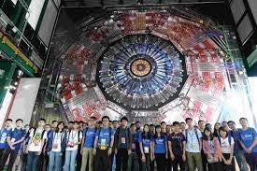
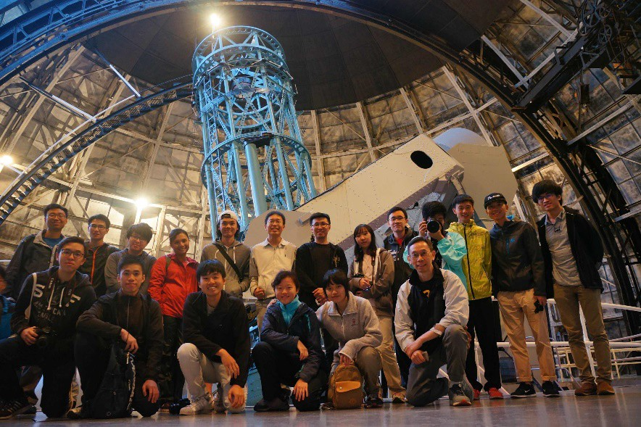
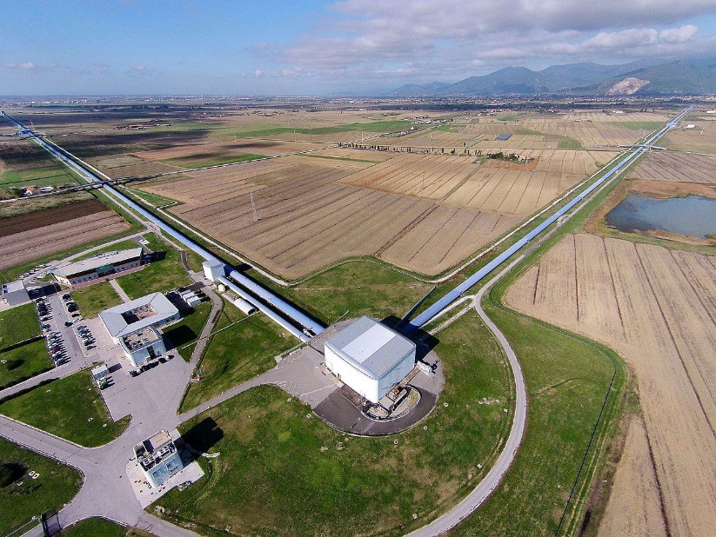
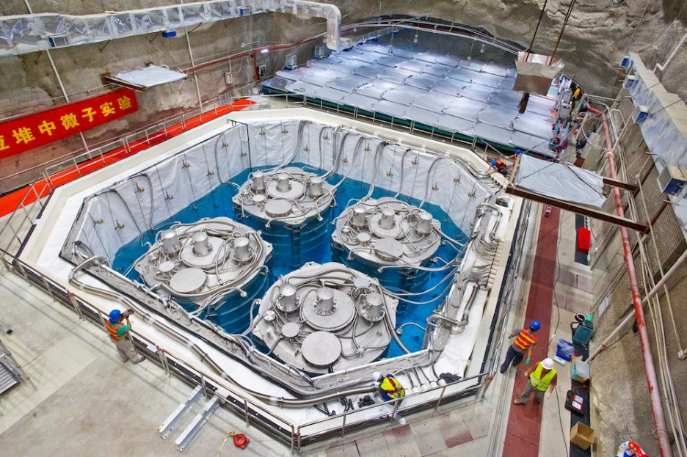
Participated in large-scale international research projects 大型國際研究項目
High energy physics at CERN 歐洲核子研究中心
Astrophysics 天體物理
LIGO for measuring gravitational
waves 重力波
Daya Bay for studying
neutrinos 中微子
Published research papers in high-impact journals.
9

Slide 10
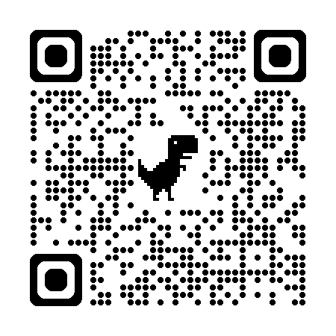
Physics at CUHK: Curriculum 課程Overview
University Physics (1st and 2nd years)
Classical Mechanics 經典力學 (2nd and 3rd years)
Quantum Mechanics 量子力學 (3rd and 4th years)
Electromagnetic theory 電磁理論 (3rd and 4th years)
Thermal and Statistical Physics 熱物理和統計物理 (3rd and 4th years)
Mathematical Skills 數學技能 (1st – 3rd years)
Experimental Skills 實驗技能 (1st – 3rd years)
Computational Skills 計算/編程技能 (2nd and 3rd years)
Other electives (3rd and 4th years)
47 (Science)/57 (ESTP) compulsory units and 24/15 elective units out of 123 total units
10

Slide 11
Four Streams (focused study)
Enrichment Stream in Theoretical Physics 理論物理精研 (JUPAS 4690 or internally transfer. You will study Methods in Theoretical Physics I, Senior Project II, etc)
Astrophysics & Particle Physics 天文物理學與粒子物理學 (You will study courses like Astrophysics, Relativity, Nuclear and Particle Physics, etc)
Quantum Science & Technology 量子科學與技術 (You will study Advanced Quantum Mechanics, Solid State Physics, Statistical Mechanics, etc)
AI & Computational Physics 人工智慧與計算物理 (You will study Basic Computational Physics, Physics Simulations with AI Tools, Computational Physics and Machine Learning, etc)
No stream

Slide 12
Enrichment Stream in Theoretical Physics 理論物理精研
For elite 精英 students who are talented in physics and mathematics (top 10 program in CUHK based on admission score 收生成績)
Critical mass 凝聚of very good students love physics
Provide a solid foundation on theoretical physics and mathematics
Provide more project learning and research opportunities
More small-group discussion classes
Guaranteed 保證 research opportunities at an earlier stage
12

Slide 13

Learning opportunities beyond classroom
SURE – Summer Undergraduate Research Exchange 暑期研究交流
Cambridge, Oxford, Caltech, CERN, LIGO, Chicago, Toronto, ….
OPUS – Overseas Program for Undergraduate Students 海外學生交流
Berkeley, Fudan
STAR – Summer Teacher Apprenticeship 暑期教師實習
Local secondary schools
Internships 實習計劃
Summer Research Internship, HK observatory, Space Museum, Science Museum
Exchange programs 大學和書院交流生計劃
University and colleges
Co-op programs 在學工作計劃
More than 75 companies participate
12

Slide 14

全球實習計劃
全球實習計畫旨在為學生提供在中國大陸及世界各地城市（如北京、柏林、布魯塞爾、開普敦、成都、杜拜、雅加達、吉隆坡、倫敦、紐約、上海、新加坡、雪梨、東京、溫哥華等）至少四週的實習機會。
Global Internship Programme (GIP) aims at offering students’ opportunities to work a minimum of four weeks in cities of Mainland China and around the world, such as Beijing, Berlin, Brussels, Cape Town, Chengdu, Dubai, Jakarta, Kuala Lumpur, London, New York City, Shanghai, Singapore, Sydney, Tokyo, Vancouver.

Slide 15

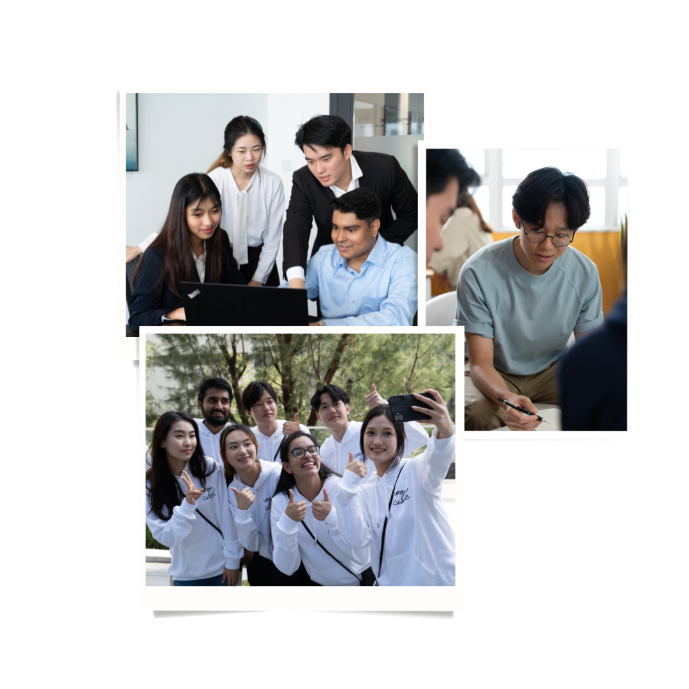
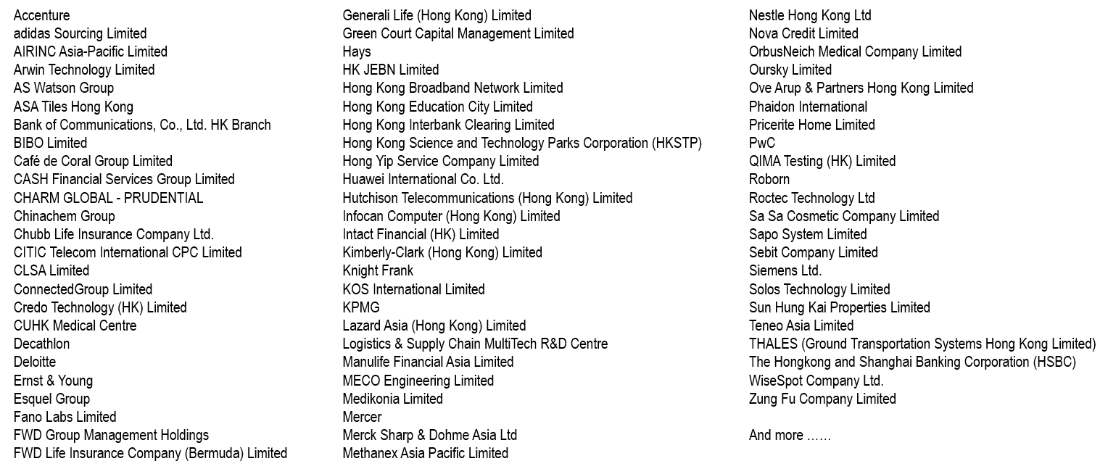
Co-op 在學工作計劃
Experiential Learning for 6 - 8 months
6–8個月的體驗式學習
Full credits 全額學分，Full-time 全日制
Full pay 全額薪酬

Slide 16
More than 35% of students participate the Summer Research Internship
暑期研究實習 in their 1st and 2nd years with financial support
More than 30-40% of students join oversea exchange program, local teaching assistant, and other internships such as HK observatory, Science Museum in 2nd and 3rd years
More than 40% of students join university/college exchange program and co-op program
All students spend at least one semester 一學期in conducting research
13

Slide 17
Science 大類收生(JS 4601)
4 Core Subjects 核心科目 Level 3 in Chinese and English Level 2 in Mathematics
Attained in Citizenship and Social Development
Best 5
Declare Physics as major programme after admission into CUHK Science
2 Elective Subjects 選修科目
1st - Level 3 in any ONE subject from Biology / Chemistry / Physics / M1 or M2 2nd - Level 3 in any ONE subject in Category A 甲類科目
Some subjects with Heavier Weighting 比重
2.0X Biology, Chemistry, Physics, Mathematics, M1 or M2
1.5X English OR Mathematics, Economics, Geography, Information and Communication Technology, Technology and Living (Food Science & Technology)
(A maximum of 3 subjects will be weighed heavier)
Bonus Point Arrangement
6th and 7th subjects in Category A or Category C or ApL Outstanding performance in interview 面試
School Principal’s Nominations (SPN) 校長推薦計劃
14

Slide 18
理論物理精研(JS 4690)
4 Core Subjects
Level 3 in Chinese and English Level 4 in Mathematics
Attained in Citizenship and Social Development
Best 5
Direct admission to CUHK Physics via JUPAS
2 Elective Subjects
1st - Level 4 in Physics
2nd - Level 3 in any ONE subject from M1 or M2 (preferred) / Biology / Chemistry / Economics / Geography / Information and Communication Technology / Technology and Living (Food Science & Technology)
Some subjects with Heavier Weighting
HKDSE Subject | Physics | Mathematics and M1/M2 | English/Chinese Language | Other Subjects in Category A
Weighting factor | × 2 | × 1.5 | × 1 | × 1
18

Slide 19
A higher weighting will be assigned to
HKDSE Physics, Mathematics & M1/M2
Extra Bonus Points will be given to
  If obtain 5** in HKDSE Physics, Mathematics & M1/M2
  Outstanding performance in interviews 面試 (Tentatively scheduled for May/June 2027)
  6th and 7th subjects in Category A
JUPAS Quota: ~19
Science 大類收生students with outstanding academic performance can apply to transfer to Enrichment Stream in Theoretical Physics 理論物理精研after their first year
19

Slide 20
JUPAS Admission Score 2026
(理論物理精研)
Admission Figures | CHI | ENG | MATH | CSD | M1/M2 | PHY (1st Elective) | ₂nd Elective | ₃rd Elective | Program Weighted Total
Upper Quartile | 4 | 4 | 5** | A | 5** | 5** | 5 | 4 | 52
Median | 4 | 5 | 5 | A | 4 | 5** | 5** | 5* | 46.75
Lower Quartile | 5 | 4 | 5* | A | 5 | 5* | 5* | 3 | 45.25
## 5** = 8.5, 5* = 7, 5 = 5.5, 4 = 4, 3 = 3, 2 = 2, 1 = 1
Phys × 2, Math * M1/M2 × 1.5
Based on admission score, we are one of the CUHK’s top 10 programs!
20

Slide 21
The STEM Talent Scheme
“3 or more stars with lowest level 3 or above” (e.g. 5*5*5*, 5**5*3, 5**5**5**, …) in 3 STEM- related elective subjects#三科 STEM 選修科目#中考獲最少三粒星
For 理論物理精研(JS4690), Physics must be one of the 3 STEM-related elective subjects
Put the science program in higher priority 高優先
Good for those who satisfy the above criteria but fail to fulfill the minimum requirement in the 4 core subjects (3322A) by one level in any one subject
  Programs will consider their applications and offer interviews to the potential applicants
  The application results will be announced as Main Round offer results 正式遴選結果
by JUPAS
#Biology, Chemistry, Physics, Mathematics Extended Module I/II, Information and Communication Technology,
Design and Applied Technology
18

Slide 22
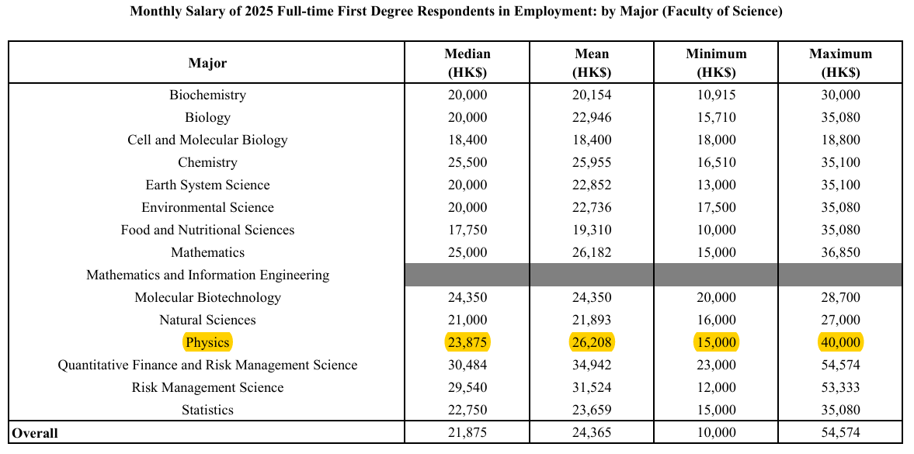

Slide 23

Alumni Sharing 校友分享

Slide 24

More Information
Undergraduate Admission Inquiry: physics@phy.cuhk.edu.hk
Physics Curriculum Inquiry: physics@phy.cuhk.edu.hk Physics Department Webpage: http://www.phy.cuhk.edu.hk Science Faculty Webpage: http://www.sci.cuhk.edu.hk/
19

